Slide 1
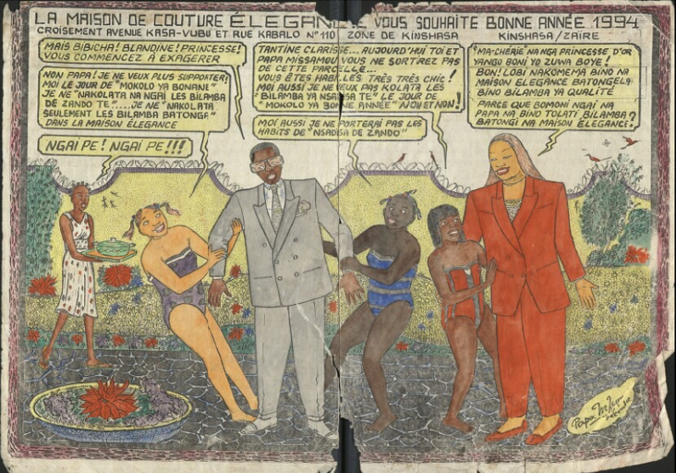

MADOC - Transcription and annotation platform
& CONGO COMICS
Ghent Centre for Digital Humanities (Ghent University) - Davy.Verbeke@UGent.be

Slide 2
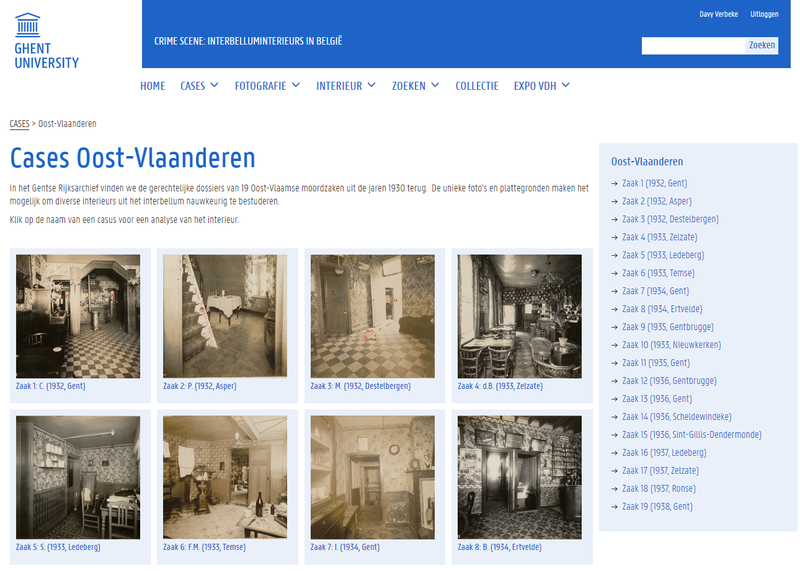
Crime scenes: interwar interiors in Belgium
MA student project
39 murder cases: court records
Omeka S Collection Exposition
Universal Viewer Tag system
https://www.omeka.ugent.be/
interieurdesign/s/plaatsdelict

Slide 3
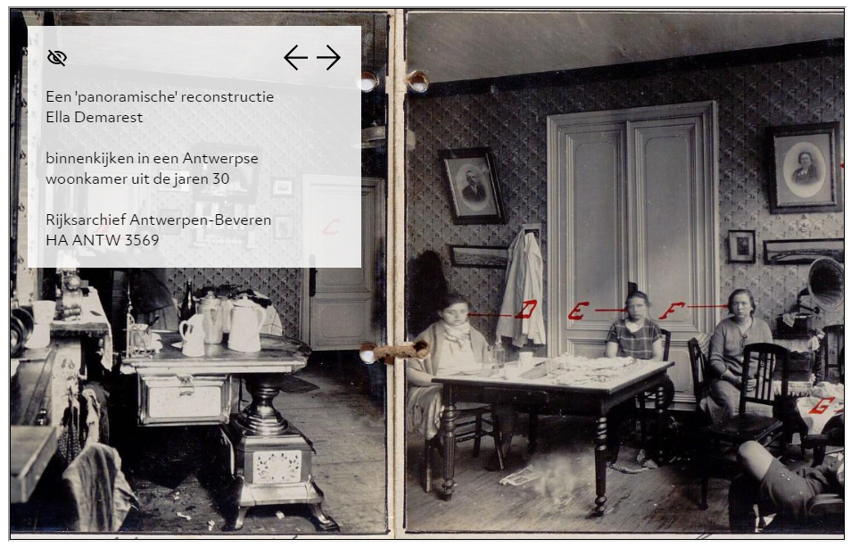
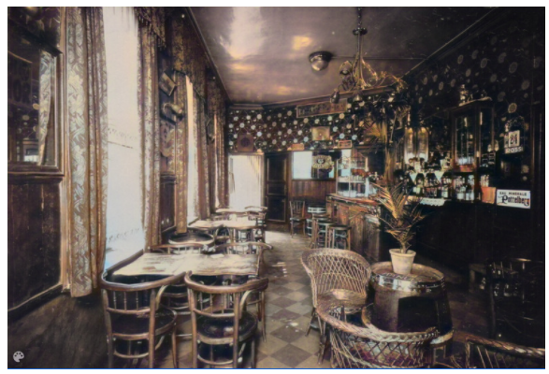
Crime scenes: interwar interiors in Belgium
Digital storytelling with Storiiies (CogApp)
IIIF module
Image colorization with DeOldify (AI)
https://www.omeka.ugent.be/interieurdesign/s/plaatsdelict

Slide 4
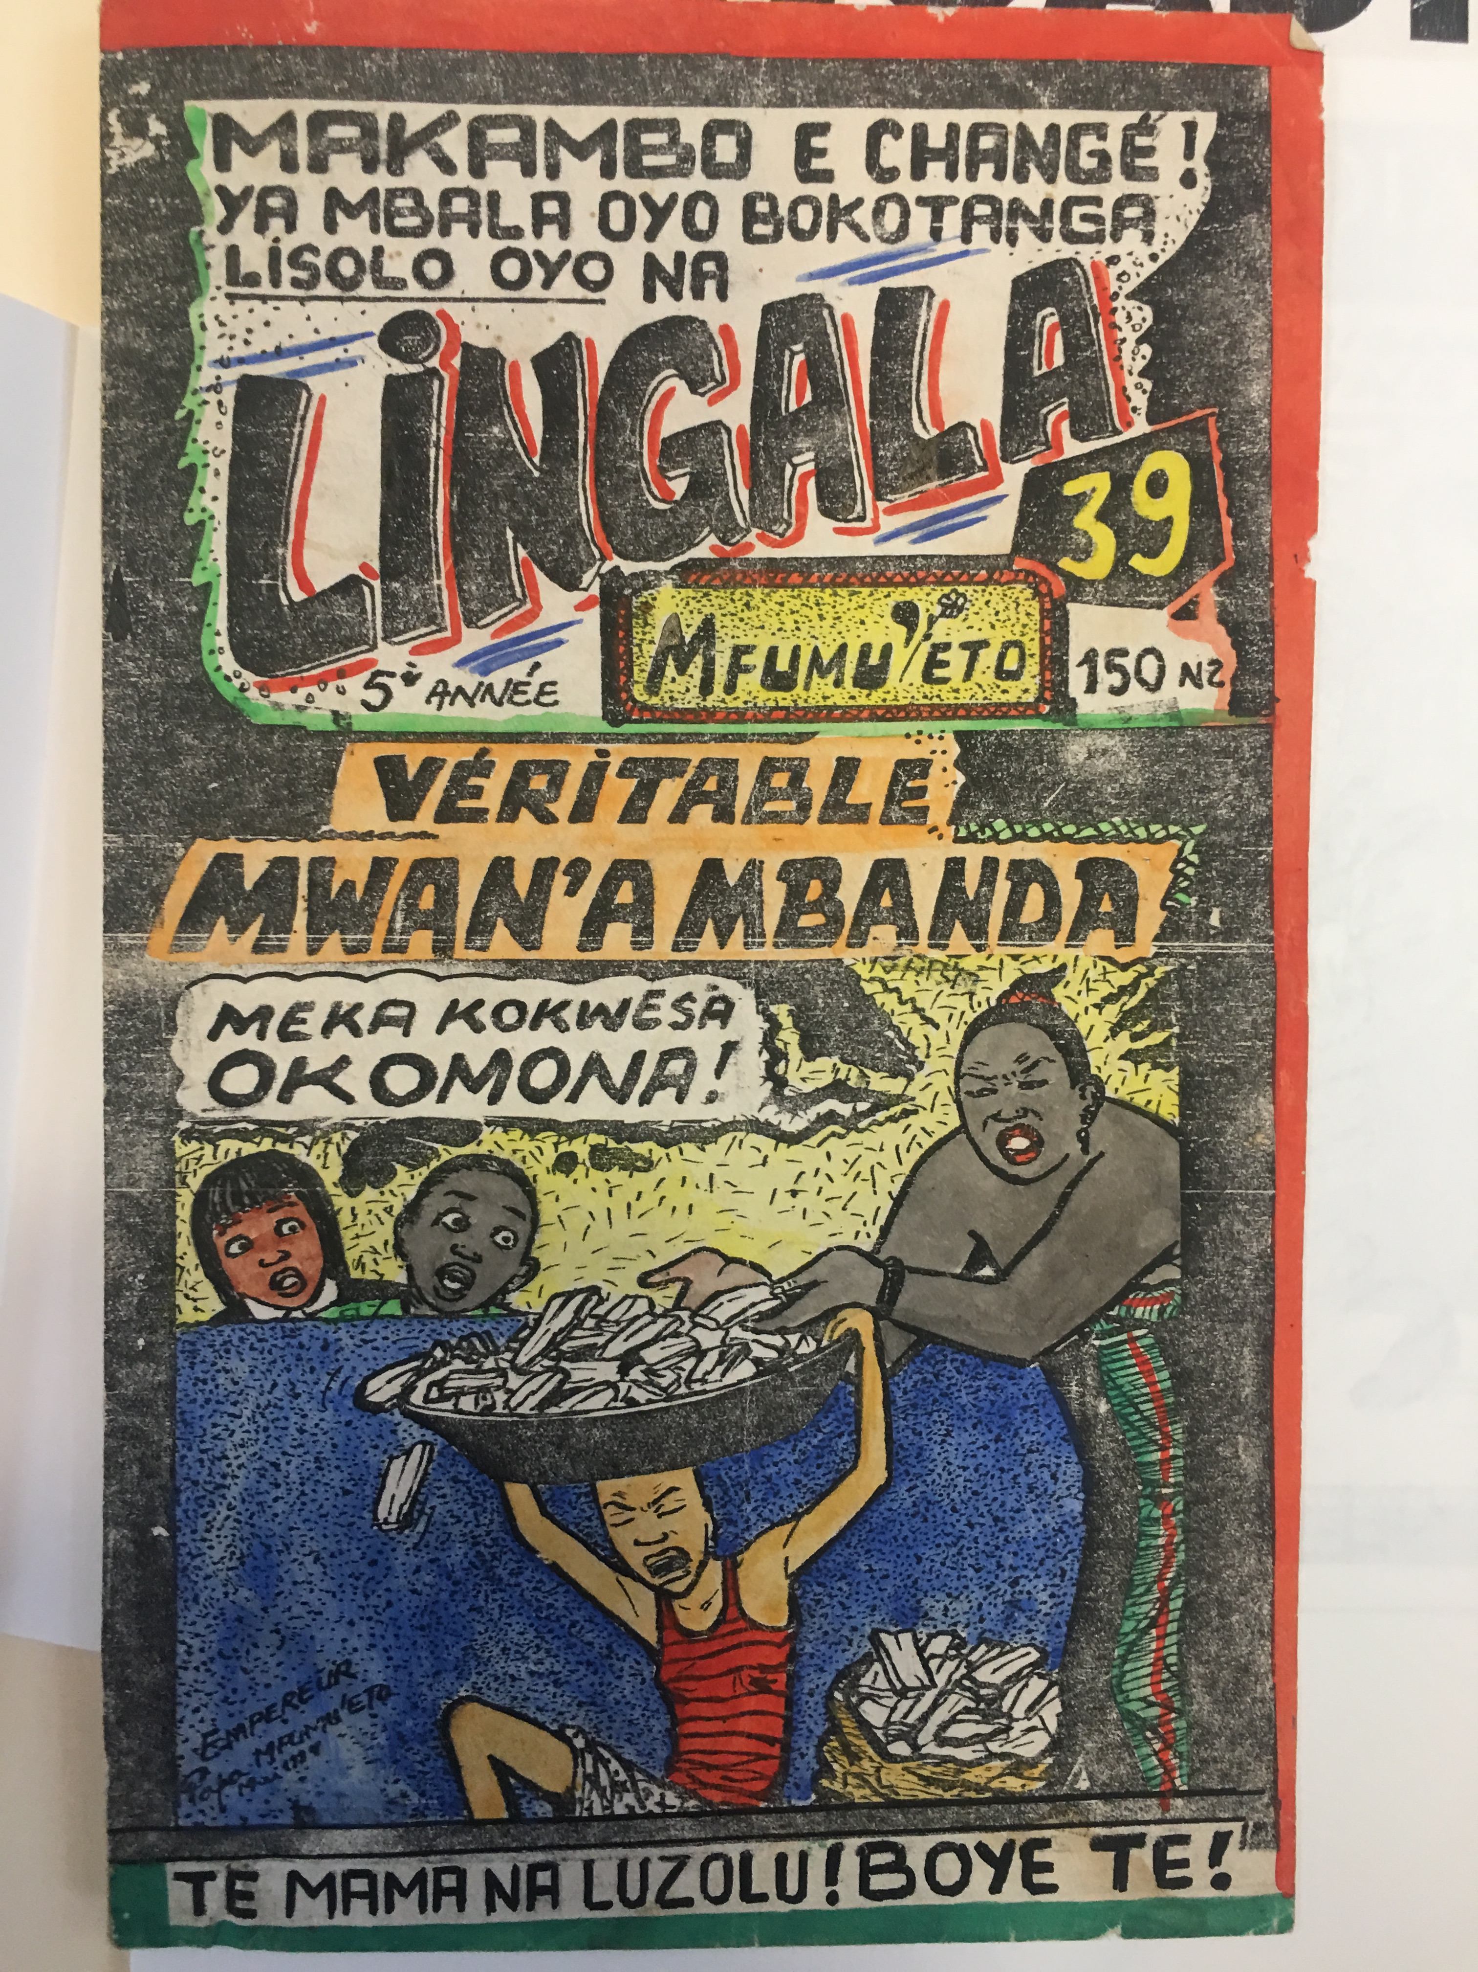
Congo comics – Papa Mfumu’eto
Papa Mfumu’eto (°1963, Congo DRC)
Comic collection (1980s-2000s)
> 300 comics (daily life and politics)
Lingala and French
Transcribe & translate
Annotate
Showcase
Physical exhibition
Student project
Lingala learning
https://www.ghentcdh.ugent.be/projects/
papa-mfumueto-comics-project
Notes:
ook petities Vernederlandsing UGent : gedrukt + geschreven

Slide 5


MADOC 2.0 – IIIF transcription and annotation platform
Open Source
Import and (re)organize IIIF manifests in collections
ENRICHMENT
Metadata, Transcriptions, Translations, Named entities, Tags, External vocabularies
CROWDSOURCE
SHOWCASE .

Slide 6
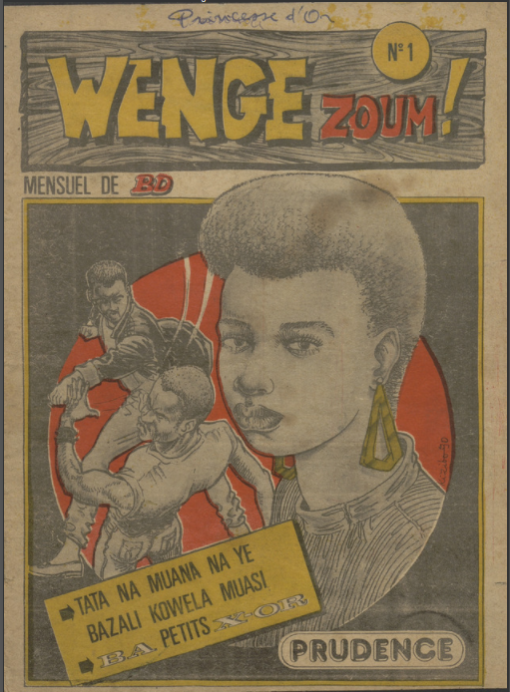
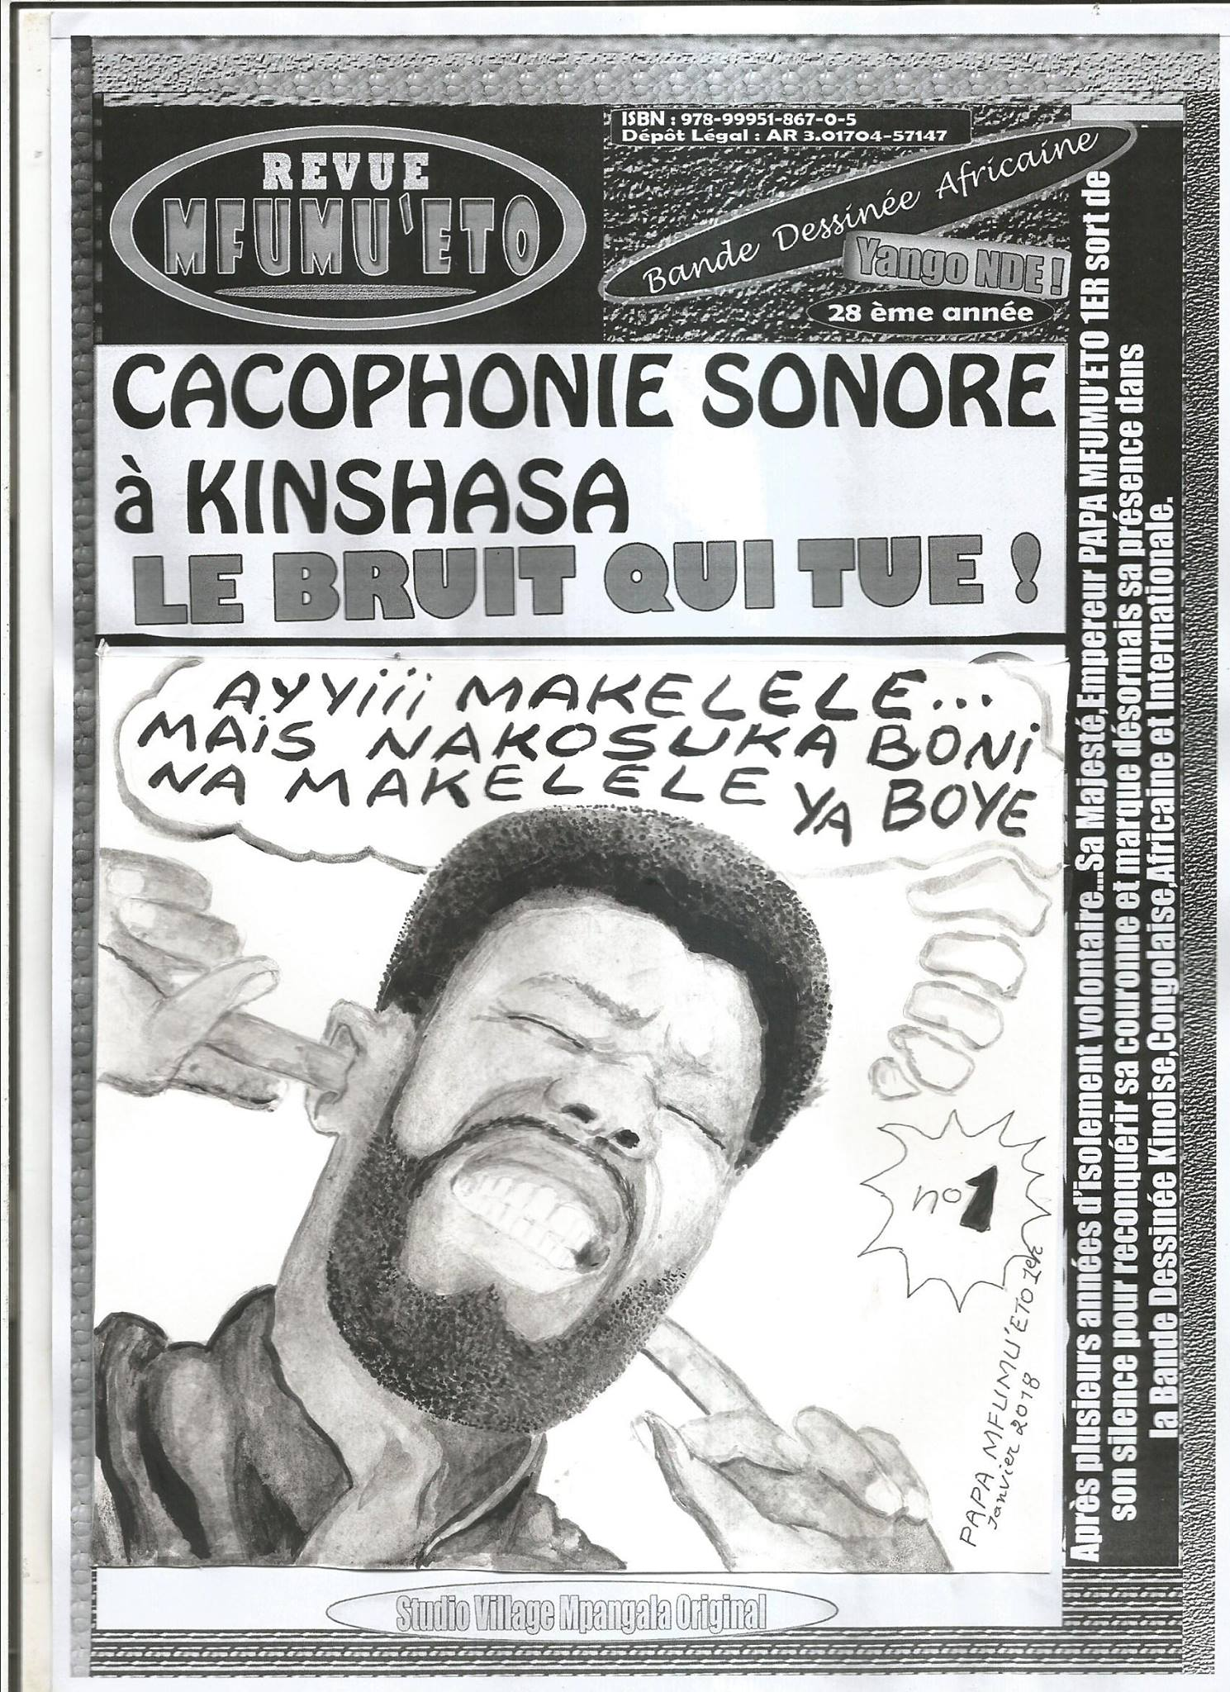
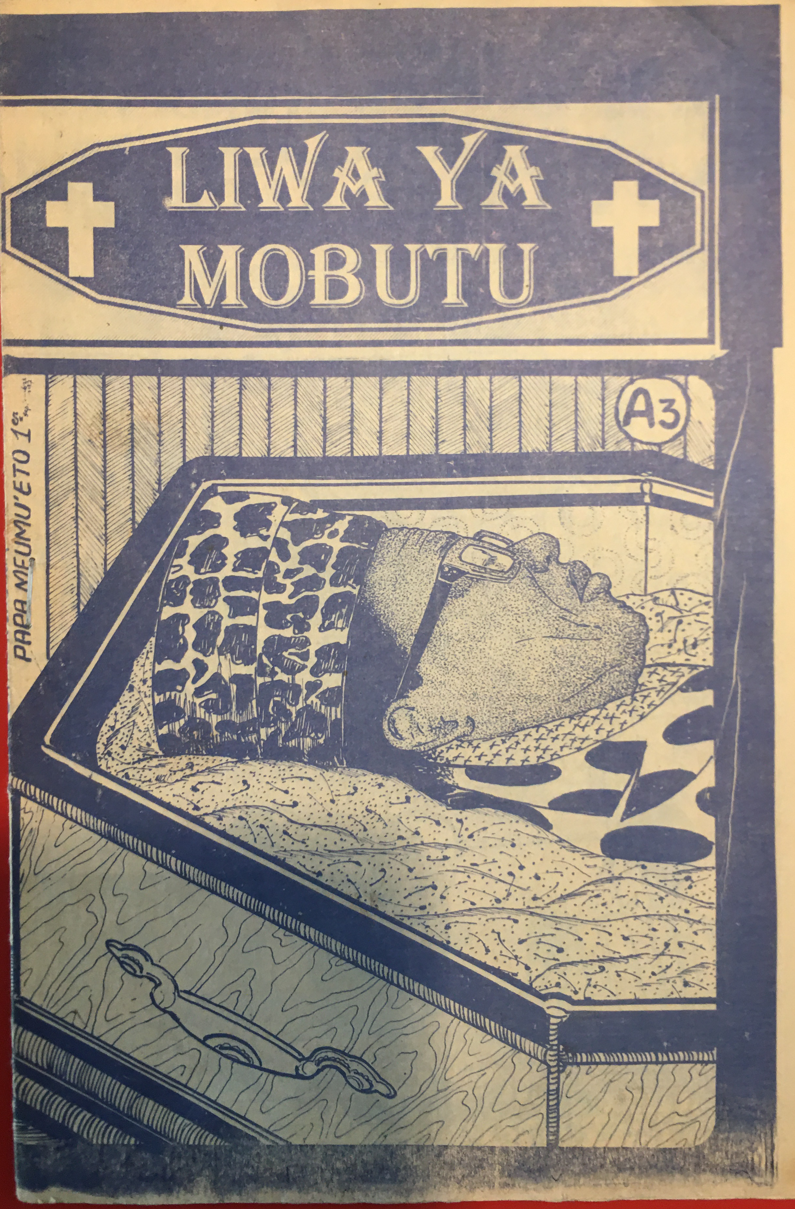
1. WORKFLOW: collection in IIIF, shared metadata model
University of Florida
Pigozzi private collection
Ghent University
Notes:
Hoe doet madoc dat?

Slide 7
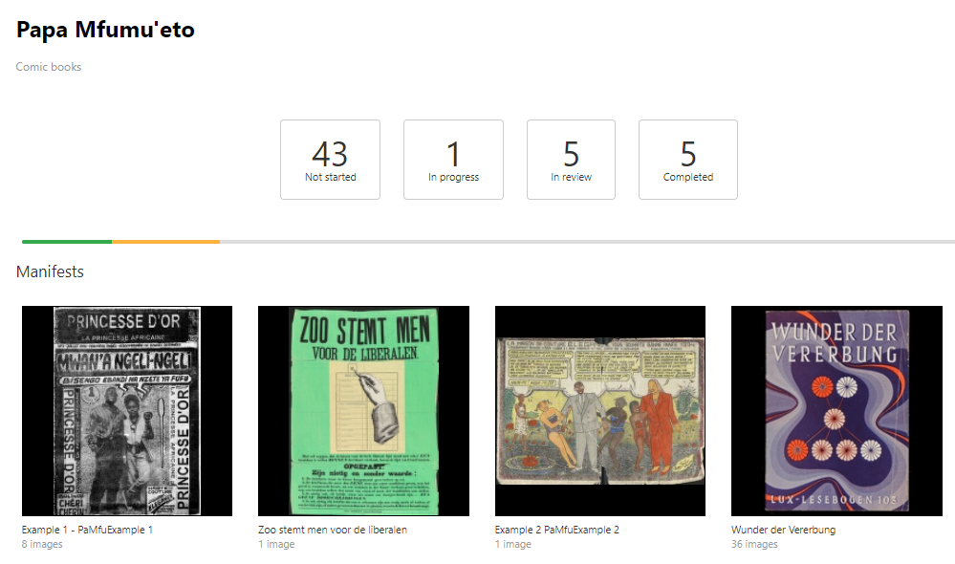
2. WORKFLOW: collections & projects (per comic)
Notes:
Een voorbeeld van een capture model waarmee Personen kunnen geannoteerd worden.

Slide 8
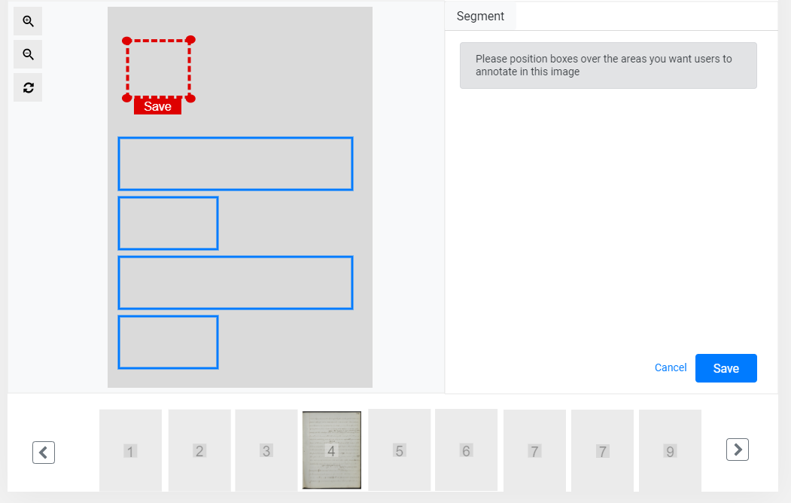
3. WORKFLOW: pre-segmentation of canvases (admin-teacher)

Slide 9
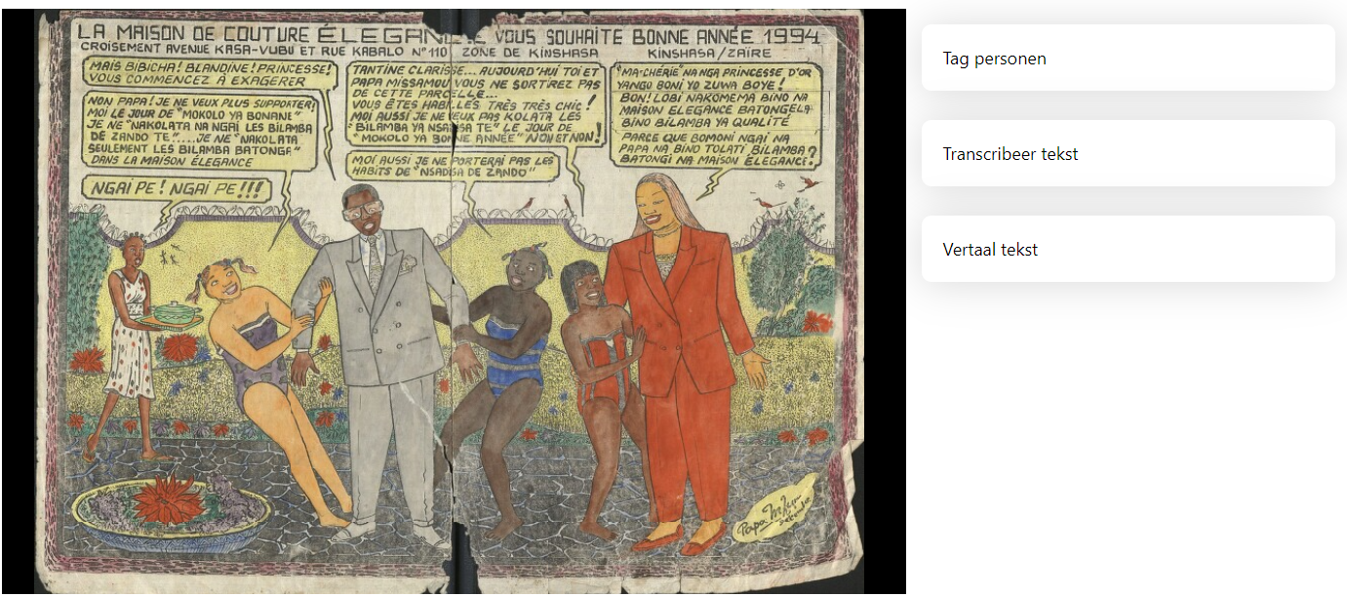
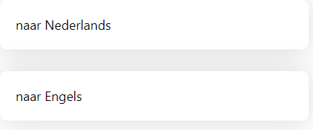
4. WORKFLOW: capture model & enrichment (students of Lingala)

Slide 10
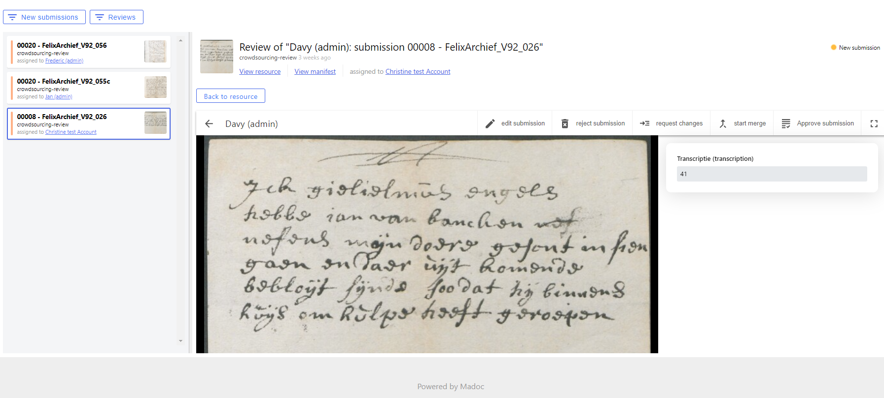
5. WORKFLOW: review, correct, merge, approve (teacher-admin)
MADOC
as a
LINGALA
LEARNING
DEVICE !

Slide 11
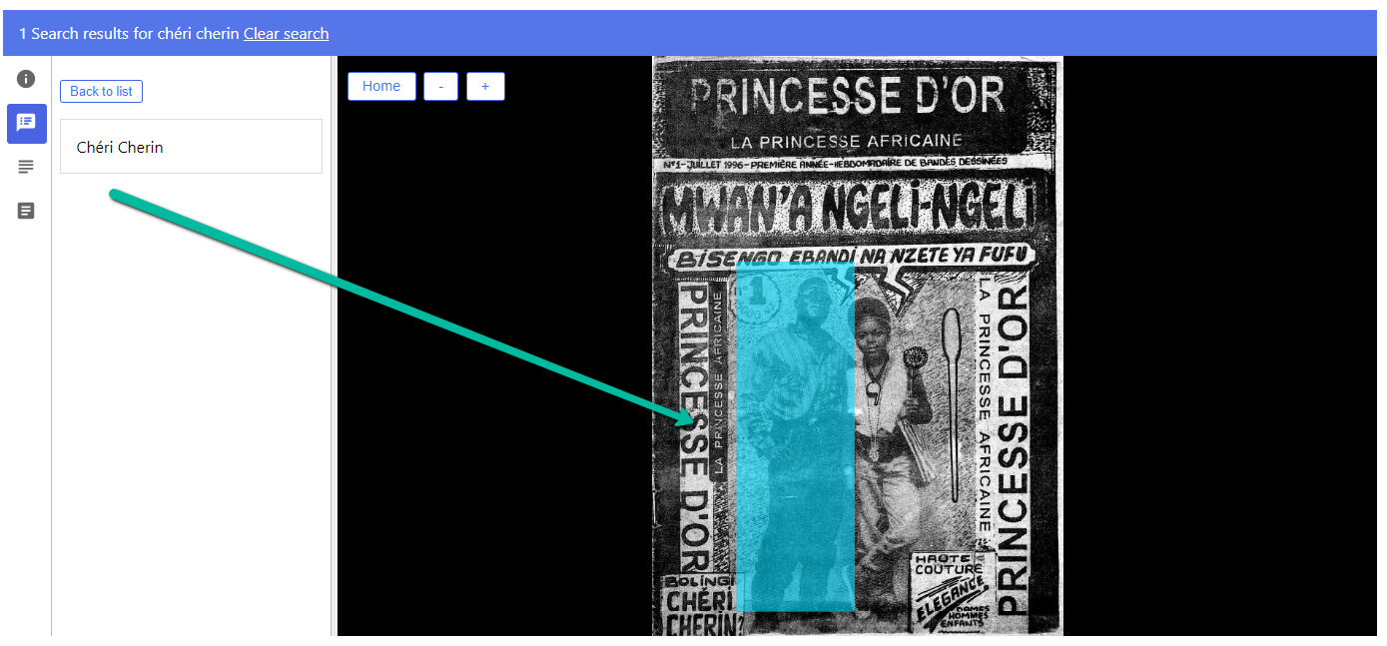
6. WORKFLOW: dissemination – online and physical exhibition

Slide 12
One piece of advice for TEACHERS implementing IIIF?
COLLABORATE WITH STUDENTS
on a shared project and
LET STUDENTS COLLABORATE

